Slide 1


What is Nvidia NIM?
Nvidia NIM (Networked Inference Manager) is a powerful cloud-native inference management platform designed for large-scale AI model deployment and scaling.
mu
by muhammad umair

Slide 2

Nvidia NIM Overview
Nvidia NIM empowers developers to effortlessly deploy and manage AI models in a secure, scalable, and cost-effective manner. It simplifies the complexities of AI inference by providing a centralized platform for monitoring, controlling, and optimizing AI workloads.
Centralized Management
Scalability
The platform is designed for scalability, allowing businesses to handle demanding AI workloads without compromising performance.
Nvidia NIM offers a centralized platform for managing AI models, simplifying deployment and monitoring.
Efficiency
Nvidia NIM optimizes resource utilization, ensuring cost-effectiveness and efficient performance for AI models.

Slide 3

Key Features of Nvidia NIM
Nvidia NIM offers a comprehensive set of features designed to simplify and enhance the deployment and management of AI models.
1
Model Deployment
2
Model Management
Nvidia NIM provides a streamlined model deployment process, simplifying the complexities of deploying AI models across various environments.
The platform offers centralized model management capabilities, allowing users to track model versions, monitor performance, and optimize resource allocation.
3
Inference Optimization
4
Security
Nvidia NIM optimizes inference performance through automated resource allocation, model optimization, and dynamic scaling.
Nvidia NIM incorporates robust security features to protect AI models and sensitive data.

Slide 4
Use Cases for Nvidia NIM
Nvidia NIM caters to a wide range of use cases, empowering businesses to harness the power of AI across various industries.
Healthcare
Finance
Retail
Nvidia NIM enables healthcare providers to deploy AI models for medical imaging, diagnosis, and personalized treatment.
Financial institutions can leverage Nvidia NIM for fraud detection, risk assessment, and algorithmic trading.
Retailers can utilize Nvidia NIM for personalized recommendations, inventory optimization, and customer insights.

Slide 5




Benefits of Nvidia NIM
Nvidia NIM delivers significant benefits to organizations looking to leverage the power of AI.
Increased Efficiency
Nvidia NIM streamlines AI model deployment and management, improving overall efficiency.
Reduced Costs
The platform optimizes resource utilization, reducing operational costs and maximizing ROI.
Enhanced Security
Robust security features protect sensitive data and AI models.

Slide 6
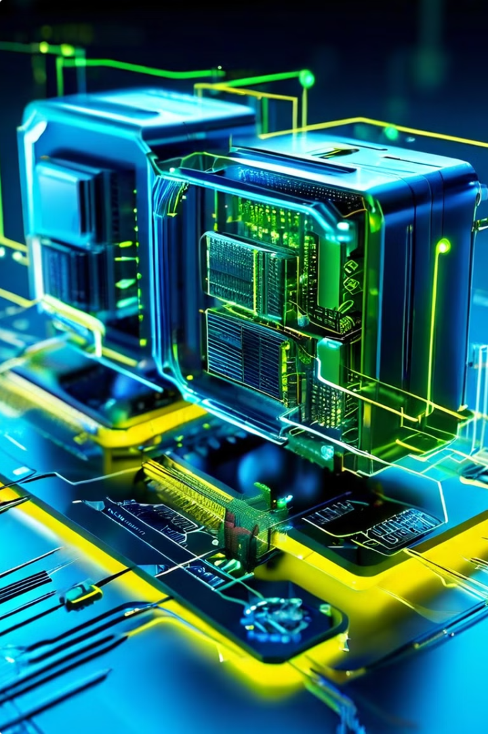
Nvidia NIM Architecture
Nvidia NIM is built on a robust and scalable architecture that ensures high performance and reliability.
Component
Description
Model Manager
Manages AI models, including versions, deployments, and performance metrics.
Inference Engine
Executes AI models efficiently and optimizes resource utilization.
Monitoring Dashboard
Provides insights into model performance, resource usage, and overall system health.
Security Layer
Ensures the security and integrity of AI models and data.

Slide 7




Nvidia NIM Integration
Nvidia NIM seamlessly integrates with various cloud platforms and hardware environments, making it a highly adaptable solution.
Cloud Platforms
Integrates with major cloud providers like AWS, Azure, and GCP.
Hardware
Supports a wide range of Nvidia GPUs and other hardware.
AI Frameworks
Compatible with popular AI frameworks like TensorFlow, PyTorch, and ONNX.

Slide 8

Conclusion and Next Steps
Nvidia NIM is a powerful platform for AI model deployment and management that offers numerous benefits to organizations. It simplifies AI workflows, enhances efficiency, and reduces costs.
1
Evaluate Nvidia NIM
Explore the features and capabilities of Nvidia NIM to determine if it aligns with your needs.
2
Deployment Planning
Develop a comprehensive deployment plan, considering infrastructure, security, and scalability.
3
Implementation and Optimization
Implement Nvidia NIM and optimize its configuration for optimal performance.

